Slide 1
Types of Instructions
native instructions:
defined by the ISA, directly corresponds to a hardware operation
idioms:
defined by the ISA, an alternate form of a hardware instruction
b label
beq $zero, $zero, label
pseudo instructions:
an alternate syntactic form of an instruction
pseudo instruction is textual replaced with native instruction
lb $t1, label+offset
lui $at, &label
lb $t1, offset($at)
macros:
user-defined pseudo instruction
average $v0, $t2, $t3
average($v0, $t2, $t3)
subroutines
user defined abstraction, resulting
jal subroutine
nop
a change in control-flow
a ownership of registers
.macro average(%d, %s, %t) addu %d, %s, %t
srl %d, 2
.end_macro
.text
subroutine: nop
jr $ra

Slide 2
Array Operations
.data
.align 2 # force word alignment
A: .space 12 # int A[3];
'c'
'a'
'r'
0
0
Memory is an array of bytes
Arrays
operations: load, load unsigned, store
data sizes: bytes, half, words -- remember alignment!
addressing: indirect addressing
address of the array must be placed into a register
Associated Instructions:
la rt, label # rt = &label
lw rt, imm(rs) # rt = rs[imm], transfers 4 bytes
sw rt, imm(rs) # rs[imm] = rt, transfers 4 bytes
lbu rt, imm(rs) # rt = rs[imm], transfers 1 byte without signed extension
Examples:
la $t1, A # t1 := 0x0000 2044
lb $s0, 0($t1) # s0 := 0xFFFF FFDE signed extension
lbu $s1, 1($t1) # s1 := 0x0000 00AF
lh $s2, 3($t1) # alignment error
lw $s3, 8($t1) # s3 := 0x00EF CDAB little Endian
lw $s4, -4($t1) # s4 := 'cab!' little Endian
0
AF
02
0x2100
02
00
EF
CD
0x204C
AB
00
CA
0x2049
FA
0x2048
00
EF
BE
61
0x2045
0
A:
AF
0x2044
DE
'c'
'a'
'b'
'!'

Slide 3
Array Pseudo Instructions
'c'
'a'
'r'
0
0
0
Standard Form
op rt, imm (rs) 4($t0)
Alternate Forms
op rt, label A
lui $at, <.data>
lb rt, 0($at)
op rt, label (rs) A($t1)
lui $at, <.data>
addu $at, $at, rs
lb rt 0($at)
op rt, label + imm A + -4
lui $at, <.data>
lb rt, imm($at)
op rt, label + imm (rs) A + 3 ($t1)
lui $at, <.data>
addu $at, $at, rs
lb rt, imm($at)
op rt, imm
lb rs, imm($zero) 0x204D
AF
02
0x2100
02
00
EF
CD
0x204C
AB
00
CA
0x2049
FA
0x2048
00
EF
BE
61
0x2045
0
A:
AF
0x2044
DE
'c'
'a'
'b'
'!'
assuming the values contained within
$t0: &A $t1: 13

Slide 4
Stack Operations
Push(a) ⇔ sp = sp + 1
sp[0] = a
x = Pop() ⇔
x = sp[0] sp = sp - 1
Stack is an abstract data structure
The stack is an array of words
Operations:
Push: Push(A), Push(B), Push(C)
Pop: X = Pop();
Push: Push(Z);
sp:
C
C
sp:
Z
sp:
B
B
sp:
B
B
sp:
A
A
A
A
A
sp:
Push(A);
Push(B);
Push(C);
X = Pop()
Push(Z)

Slide 5
But the MIPS Way
Push(a) ⇔
sp = sp - 1
sp[0] = a
x = Pop() ⇔
x = sp[0] sp = sp + 1
Stack is an abstract data structure
Operations:
Push: Push(A), Push(B), Push(C)
Pop: X = Pop();
sp: points to the current top of stack
Push(a) ⇔
subi $sp, $sp, 4
sw $a0, 0($sp)
x = Pop() ⇔
lw $v0, 0($sp) addi $sp, $sp, 4
sp:
A
A
A
A
sp:
B
B
sp:
B
sp:
C
C
Push(A);
Push(B);
Push(C);
X = Pop()

Slide 6
Multiple Pushes / Pops
push(a) ⇔
sp = sp - 1
sp[0] = a
x = Pop(x) ⇔
x = sp[0] sp = sp + 1
sp:
push(a) ⇔
subi $sp, $sp, 4
sw $a0, 0($sp)
x = Pop(x) ⇔
lw $v0, 0($sp) addi $sp, $sp, 4
sp:
X
X
Push(t0);
Push(t1);
Push(t2);
sp:
t0
sp:
t1
sp:
t2
t0 = Pop();
t1 = Pop();
t2 = Pop();
sp:
X
sp:
X
subi $sp, $sp, 12
sw $t0, 8($sp)
sw $t1, 4($sp)
sw $t2, 0($sp)
t0
sp+8
lw $t0, 8($sp)
lw $t1, 4($sp)
lw $t2, 0($sp)
addi $sp, $sp, 12
t1
sp+4
sp:
t2
sp+0

Slide 7
Macros
Uses:
to improve readability of your program
to eliminate repetitive code construction
to reduce overhead associated with subroutines
Register usage must be carefully considered
Register Approaches:
New Pseudo Instruction: use the $at register -- but don't use any pseudo instructions
Marshalling: use only the registers provided as arguments
Inlined- subroutine: Utilize: $a0, $a1, $a2, $a3, $v0, and $v1
Syntax:
.macro <name>(%arg1 .. %argn) <list of native instructions> .end_macro

Slide 8
Macros: New Pseudo Instruction
Usage: push rt .macro push(%rt)
sw %rt, 0($sp)
subi $sp, $sp, 4
Usage: pop .macro pop()
addi $sp, $sp, 4
Usage pop rt .macro pop(%rt)
lw %rt, 0($sp)
addi $sp, $sp, 4
Usage: rsubi rd, rt, imm # rd = imm - rs .macro rsubi (%rd, %rt, %imm)
li $at, %imm
sub %rd, $at, %rt
Usage: load10_w label .macro load10_w(%label)
la $at, %label
lw $t0, 0($at)
lw $t1, 4($at)
lw $t2, 8($at)
lw $t3, 12($at)
lw $t4, 16($at)
lw $t5, 20($at)
lw $t6, 24($at)
lw $t7, 28($at)
lw $t8, 32($at)
lw $t9, 36($at)
Usage: store10_w label

Slide 9
Macros: Marshalling
marshall: to arrange or assemble in correct order
.macro exit_i(%imm)
li $v0, 17
li $a0, %imm
syscall
.macro exit_r(%reg)
li $v0, 17
mv $a0, %reg
syscall
.macro save_s_registers()
subi $sp, $sp, 32
sw $s0, 28($sp)
sw $s1, 24($sp)
sw $s2, 20($sp)
sw $s3, 16($sp)
sw $s4, 12($sp)
sw $s5, 8($sp)
sw $s6, 4($sp)
sw $s7, 0($sp)
.macro read(%fd, %buff, %count)
li $v0, 16
move $a0, %fd
la $a1, %buff
move $a2, %count
syscall
.macro return(%reg)
mv $v0, %reg
.macro restore_s_registers()
sw $s0, 28($sp)
sw $s1, 24($sp)
sw $s2, 20($sp)
sw $s3, 16($sp)
sw $s4, 12($sp)
sw $s5, 8($sp)
sw $s6, 4($sp)
sw $s7, 0($sp)
addi $sp, $sp, 32

Slide 10
Macros: Inlined Subroutines
x = average (a, b) .macro average
addu $v0, $a0, $a1
srl $v0, 2
.macro strlen(%str) #int strlen(str) { la $a0, %str # p = &str; li $v0, 0 # count = 0; test: # while (*p != '\0') { lb $at, 0($a0) # // (*p) beq $at, $zero, done # // beq:!($at !=0) addi $a0, $a0, 1 # p++ addi $v0, $v0, 1 # count++ b test # } done: # return count #} .end_macro
next:
00
p
EF
'\0'
'g'
'n'
'i'
'r'
't'
's'
str: .ascii "my " .asciiz "string"
next: .half 0x00EF
' '
61
0
str:
'y'
'm'

Slide 11
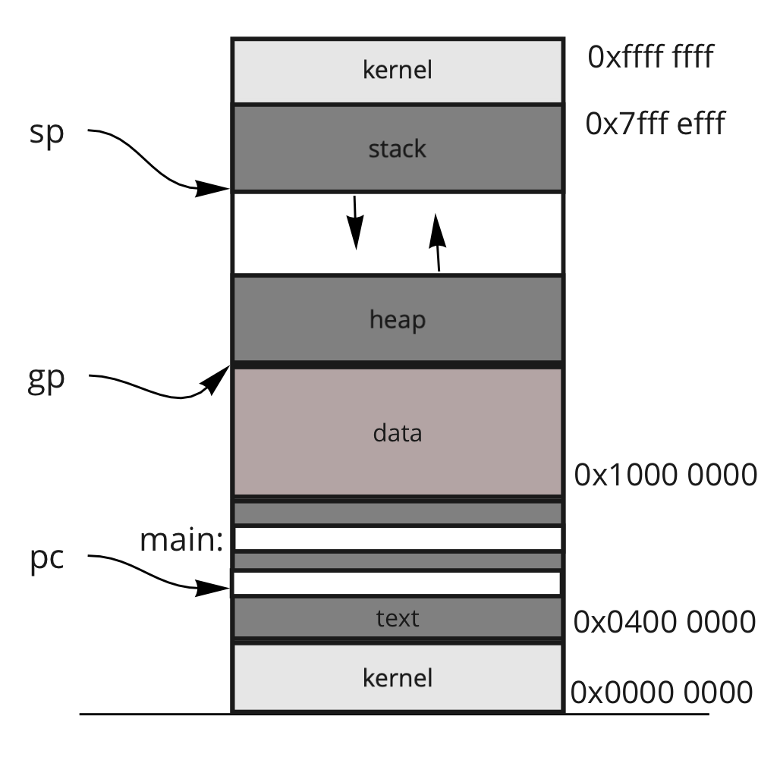
Frames
current address saved in a register
well-known addresses
Frame: a collection of variables:
Classes variables → "heap"
Methods variables → "stack"
Static variables → ".data"
args
locals
main
temps
args
fp:
locals
A
temps
args
sp:
C
locals
temps

Slide 12
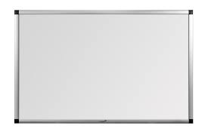
Subroutines
Save! s registers
Causes:
a change in control-flow: jal, jr $ra
a change in ownership of registers
A Subroutine Calling Convention Exists
pushing arguments onto the stack
MIPS Conventions ($a0, $a1, $a2, $a3) → {$v0, $v1}
preserving registers (e.g., temps) onto the stack
Special cases (short circuit the MIPS Calling Convention)
Main subroutine: the first subroutine in the dynamic call graph
No need to save the "s" registers upon entry
Give preference to "s" register utilization
Leaf Subroutines: the last subroutine in the dynamic call graph
Give preference to "t" register utilization
checkout "isqrt" -- does not save registers

Slide 13
Layout of the Frame
FormalArgs
Locals
fp:
X
X ⇔ 0($fp)
Y ⇔ -4($fp)
Z ⇔ -8($fp)
j ⇔ -12($fp)
k ⇔ -16($fp)
t0 ⇔ -20($fp)
-
t9 ⇔ -56($fp)
s0 ⇔ -60($fp)
s7 ⇔ -88($fp)
gp ⇔ -92($fp)
sp ⇔ -96($fp)
fp ⇔ -100($fp)
ra ⇔ -104($fp)
Temps
Y
Z
int my(int X, int Y, int Z) {
int j;
int k = Y + Z
j = sub(1, k, 3);
;
return j; }
When do we store values onto the frame?
in theory?
in practice?
j
k
t0
Referencing variables
My Frame
...
s0
...
gp
sp
fp
sp:
ra
Args to "sub"
sp:
1
sub(1,k,3)
Return from "sub"
k
sp:
3

Slide 14
Practicum on Subroutines
Recall fprintf(stdout, "Stored Checksum: %d, Computed Checksum: %d\n", checksum, complement); → print_string(), print_int(),print_string(), print_int(),print_char()
Turns out, working with strings is problematic
strings can be of arbitrary sizes
need to allocate space:
.data -- not thread safe
heap -- memory leak: malloc() → free()
stack -- dangling reference
buffer overflow issues --- security!
strlen: length of a string
u2a: unsigned word to ascii

